Slide 1
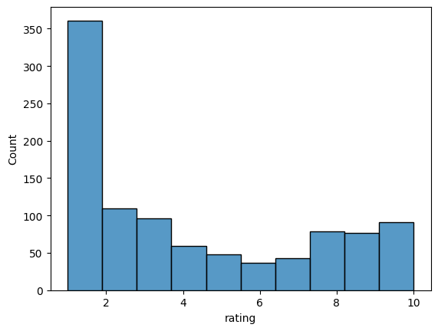
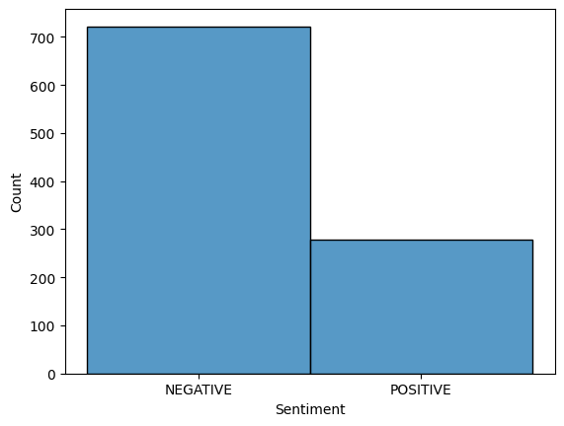
BA Reviews Analysis
More than 50% reviews are negative reviews, show that customer do not satisfy with BA services
Based on word cloud, the problem occur for seat arrangement, business class section, food, delay and refund management

